Slide 1
Comparison Budget - Cars
Deviant Art, Cars, 9/8/18, https://www.deviantart.com/mimilechampi/art/Vectorial-car-training-313180794
By: pmartin 9/8/18

Slide 2
Day One:
Open Google Sheets and name New Document “Product Comparison”
Copy Column titles A through G (Product – “Price per Year” )
Select Row 1 – format row to “wrap text”, center, bold
Decide on other variables that you find important in a car
add at least 3 , for example: color, # of seatbelts) and add to cells H1 – J1
Decide which cars you would like to investigate
Under “Product Column” List the 5 cars you have chosen (fill in cells from A2 – A6)

Slide 3
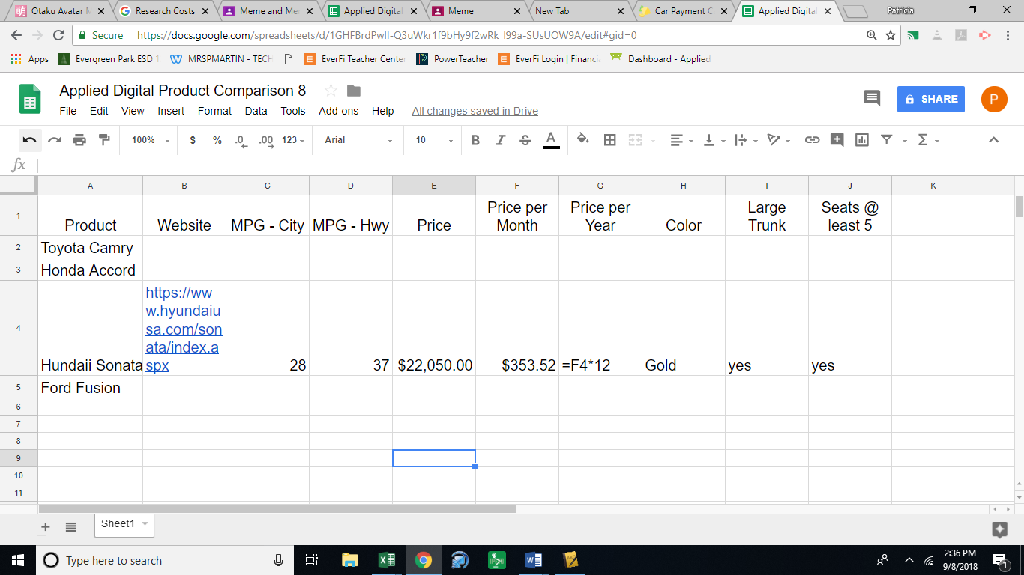

Slide 4
Day 2
Begin research for each car
Fill in each cell accordingly
Select Column B and format text to “wrap”
Format “Price Per Year” and“Price Per Month” cells to currency
Display dollar sign($) / 2 decimal places

Slide 5
Day 3
Use car calculator to determine montly payments for each car- https://www.carpaymentcalculator.net/
Fill in “Price Per Month in column “F”
Type formulas in “Price per Year” in cells in column “G”

