Slide 1
Citizenship
By: 6A

Slide 2
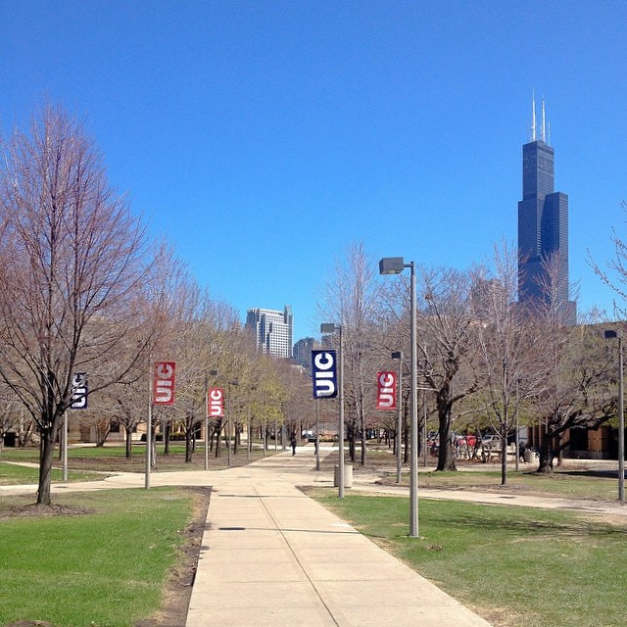
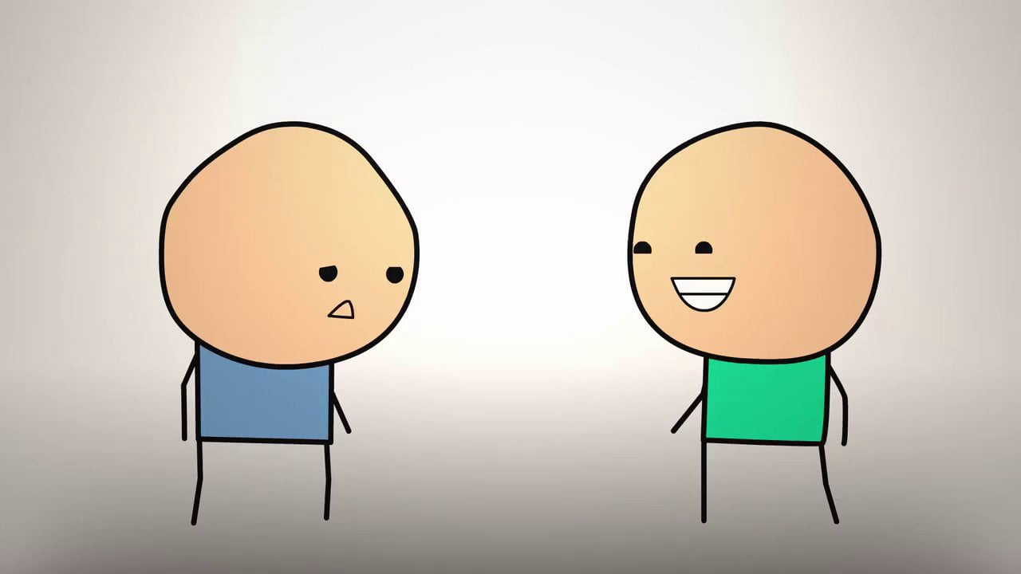
Bad behavior or Bad Citizen 😢
Hi Brandon, how was your day.
Why is he so annoying!!!!

Slide 3
Good behavior or Good citizen 😆
Don’t worry if you want we could do whatever you want.
So I am having a really bad day.

Slide 4
Bibliography
Flickr, chicago landscape, 4/25/16
www.flickr.com/photos/peterhess/14146383994
Vimeo, and happiness, 4/25/16
https://vimeo.com/78057588

Slide 5
Be A Good Person

Slide 6
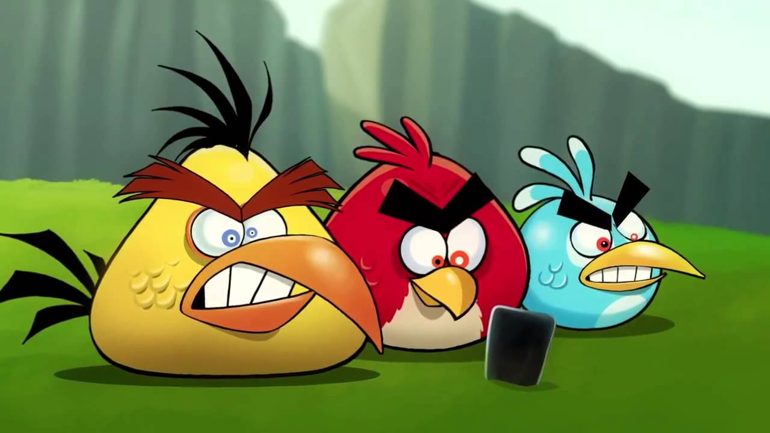
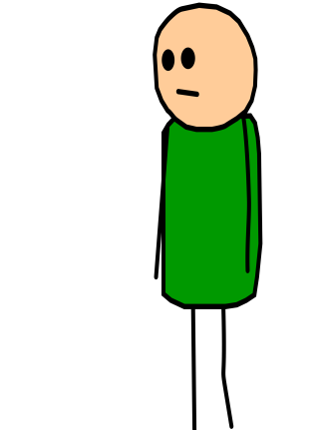
Do not text not bad to some at school and that you are at the school you can get in trouble.
Haha i just send a message and it was a mean message.
I do not like the text message I get from one of the students
Do not be mean to other people at all

Slide 7
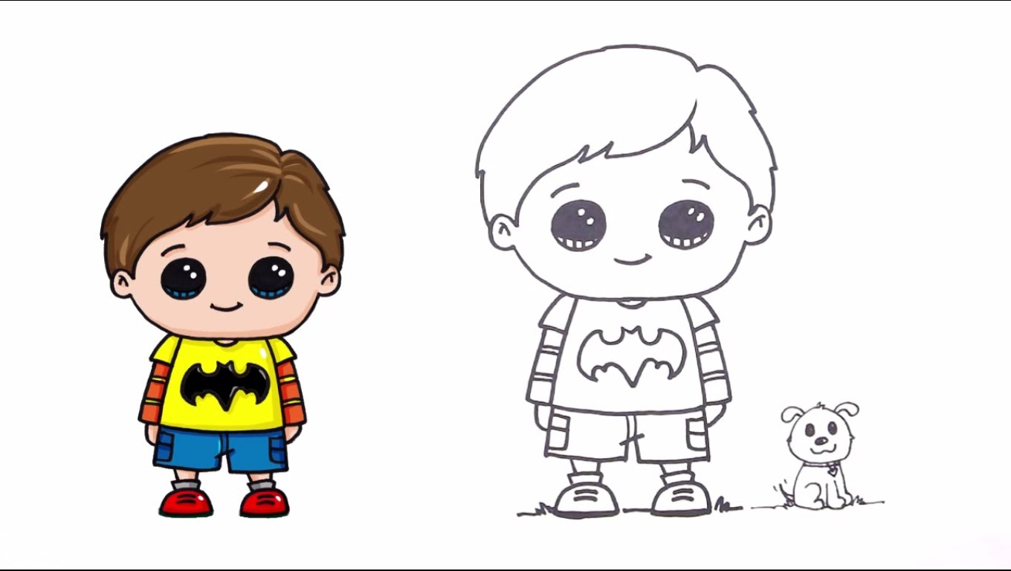
Do not bully people or be mean to them!
I do not want him to bully me
Be Good to other and they well be good to you 😀

Slide 8
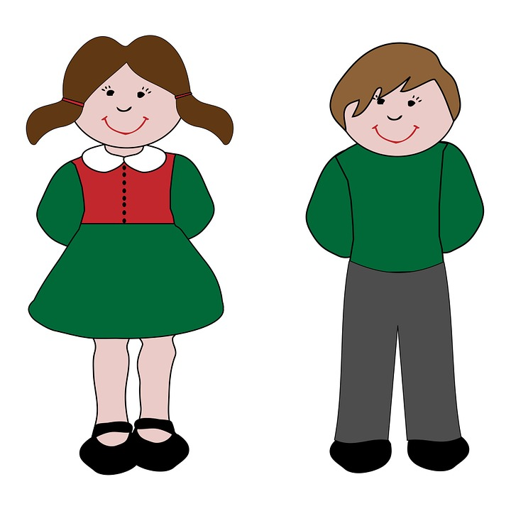
She was nice to us and is like a friend to and not a bully.
Good behavior and positive behavior
www.flickr.com/photos/kjarrett/7841950486

Slide 9
Bibliography
http://towson.shownbyphotos.com/Towson-stephens-hall-pictures.html
https://en.wikipedia.org/wiki/Middletown_High_School_North
www.flickr.com/photos/kjarrett/7841950486.

Slide 10
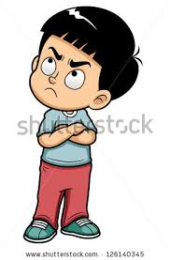
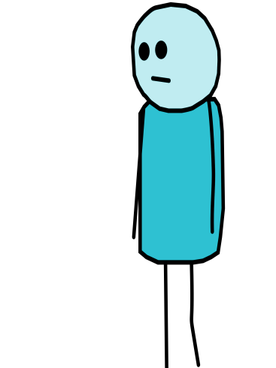
I don't care about that kid so i won't tell the teacher about what happened….
Hey loser what are you doing!!!Get out of my way
Sorry...

Slide 11
https://en.wikipedia.org/wiki/Middletown_High_School_North
Hey,you why don't you leave him alone for once.
Whatever...
Thanks.

Slide 12
Biography
https://en.wikipedia.org/wiki/Middletown_High_School_North
www.pinterest.com/pin/365424957239635965/
https://www.google.com/url?sa=i&rct=j&q=&esrc=s&source=images&cd=&cad=rja&uact=8&ved=0ahUKEwijrp2czqrMAhWrvIMKHVmVDBQQjB0IBg&url=http%3A%2F%2Fwww.pixhd.host%2Fs%2Fsad-fat-kid-cartoon.html&psig=AFQjCNHRONROiQcoXn8BuZFhjjOo0xexfQ&ust=1461701934933460
https://www.google.com/url?sa=i&rct=j&q=&esrc=s&source=images&cd=&cad=rja&uact=8&ved=0ahUKEwjin8GH_a7MAhUimYMKHQvbDw8QjB0IBg&url=http%3A%2F%2Fwww.aqusagtechnologies.com%2Fwhat-is-it-that-separates-a-good-website-from-a-bad-website%2F&psig=AFQjCNGOLW5V6KZCO0gdmWf8b6-K6__jmQ&ust=1461851956484704

Slide 13
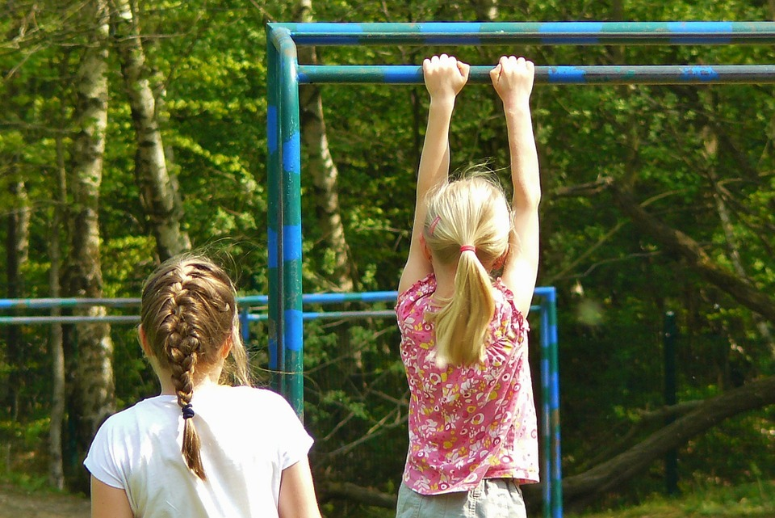
Hey!
Get off!
Wait your turn!
Rude. Don’t do this!!!
Negative
Behavior
😔
https://pixabay.com/en/photos/playground/?cat=people

Slide 14
Do this.
Hey are you almost done.
Yeah I’m done.
Positive
Behavior
😊
https://pixabay.com/en/photos/playground/?cat=people

Slide 15
Bibliography
Wikipedia, Hallway, 4/25/16, https://en.wikipedia.org/wiki/File:Penobscot_Valley_High_School_-_main_hallway.jpg
Deviantart, Michael Jackson, 4/25/16, http://mj-fan58.deviantart.com/art/Michael-Jackson-As-Cartoon-168423669
Flickr, Michael Jackson, 4/25/16, https://www.flickr.com/photos/vectorportal/6996042387
Pixabay, Playground, 4/25/16https://pixabay.com/en/photos/playground/?cat=people
Wikimedia, Thumbs Up, 4/25/16, https://commons.wikimedia.org/wiki/File:Thumbs_up_font_awesome.svg

Slide 16
What to and NOT to do in the Schoolyard
By: Rodolfo Yaber

Slide 17
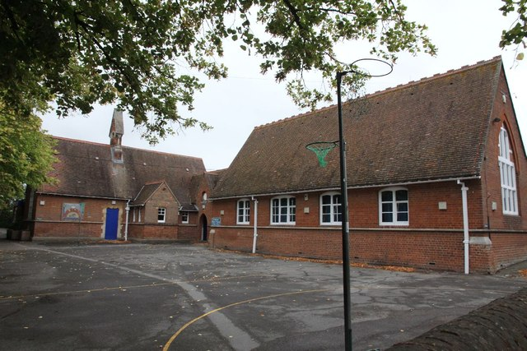
Yeah you're really short!
I think i’m gonna cry
You’re so short!
What not to do 😞

Slide 18
Pizza steve!!!!! says your really cool
Thank you I feel much better now
What to do 😁

Slide 19
Bibliography
Geograph, school yard, 4/25/16 http://www.geograph.org.uk/photo/2617653
Wikidpedia, cartoon character, 4/25/16 https://en.wikipedia.org/wiki/Cyanide_%26_Happiness
Flickr cartoon 4/25/16 https://www.flickr.com/photos/56866338@N06/8725704289
Pixabay sad boy 4/25/16 https://pixabay.com/en/boy-cartoon-child-comic-characters-1296150/
Deviantart pizza steve 4/25/16http://badboylol.deviantart.com/art/Pizza-Steve-540961819
Domain Schoolyard 4/27/16 http://www.public-domain-image.com/free-images/people/children-kids/students-learn-about-schoolyard-habitats/attachment/students-learn-about-schoolyard-habitats

Slide 20
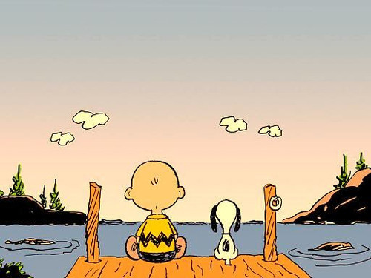
👎Bad Citizen
The sky sure does look nice today! 😊
No it is not! I’m getting bored! 😠
https://www.flickr.com/photos/michellerocks/5002342589

Slide 21
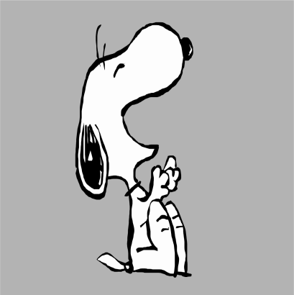
👍Good Citizen
The sky sure looks nice today! 😊
I like how there are different colors 😃
https://www.flickr.com/photos/michellerocks/5002342589

Slide 22
Bibliography
Fickr, Snoopy 4/25/16, https://www.flickr.com/photos/michellerocks/5002342589
Sketchport , Snoopy dog 4/25/16
https://www.sketchport.com/drawing/6199784754905088/laughing-snoopy

